Slide 1

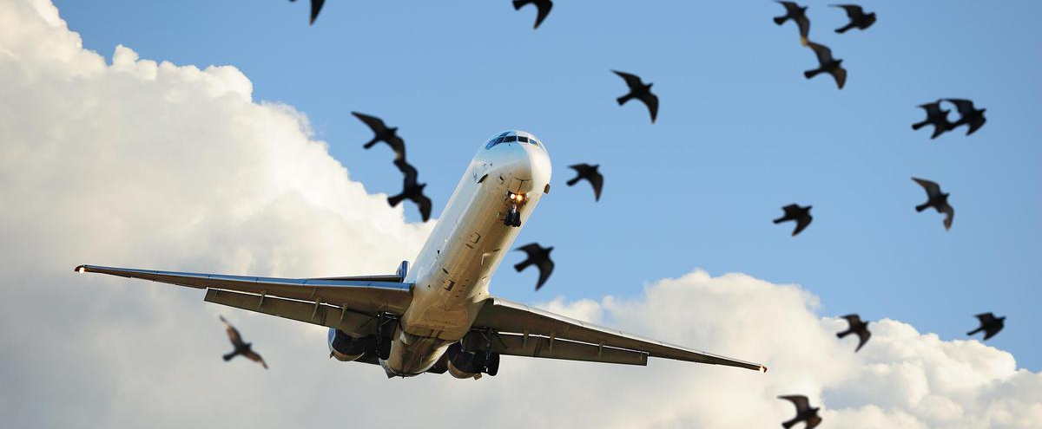
Data Visualization of Bird Strikes between 2000 – 2011

Slide 2
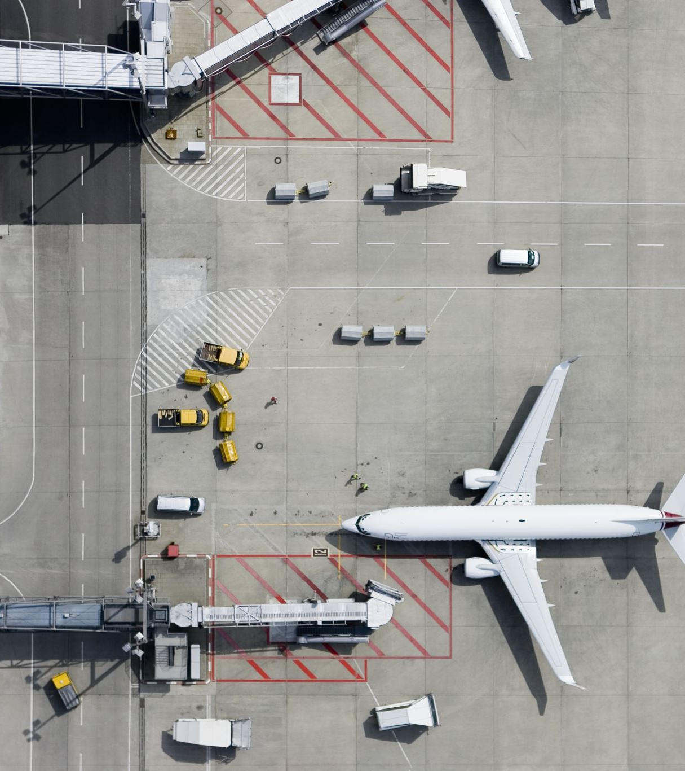
Introduction
Bird strikes, collisions between birds and aircraft, pose significant aviation safety threats, potentially causing severe damage and fatal accidents. This report analyzes FAA bird strike data from 2000 to 2011, focusing on incident numbers, trends, affected airlines, and airports. 🛫

Slide 3

Problem Statement
Analyze the bird strike data from 2000 to 2011 to identify patterns and trends in bird strikes, including the frequency, timing, and impact on flights.

Slide 4

OBJECTIVE
This involves analyzing various factors such as the time, location, altitude, and type of aircraft involved in the strikes to understand the conditions under which bird strikes occur most frequently

Slide 5

visualization

Slide 6
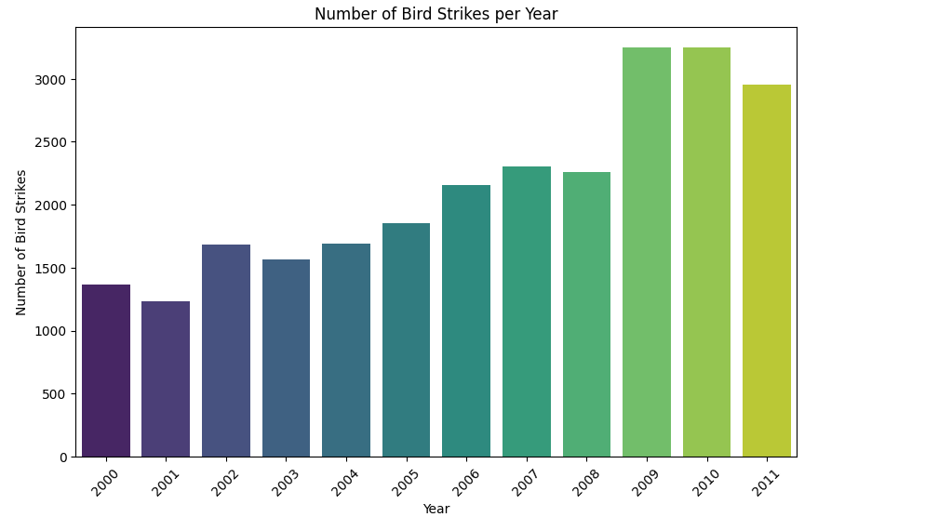
Visuals Depicting the Number of Bird Strikes
Trend: Increasing from 2000 to 2011.
2000: ~1500 strikes.
2001: ~1200 strikes.
2007: ~2500 strikes.
2009-2010: ~3200 strikes each year.
2011: ~3000 strikes.

Slide 7
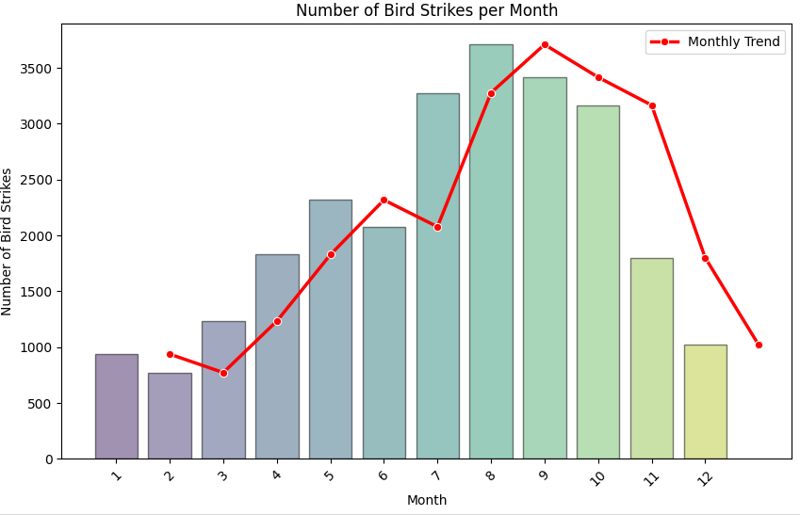
Visuals Depicting the Number of Bird Strikes
Significant Growth: 2011 had notably more strikes than 2000.
Trend: Increasing from 2000 to 2011.
2000: ~1500 strikes.
2001: ~1200 strikes.
2007: ~2500 strikes.
2009-2010: ~3200 strikes each year.
2011: ~3000 strikes.

Slide 8
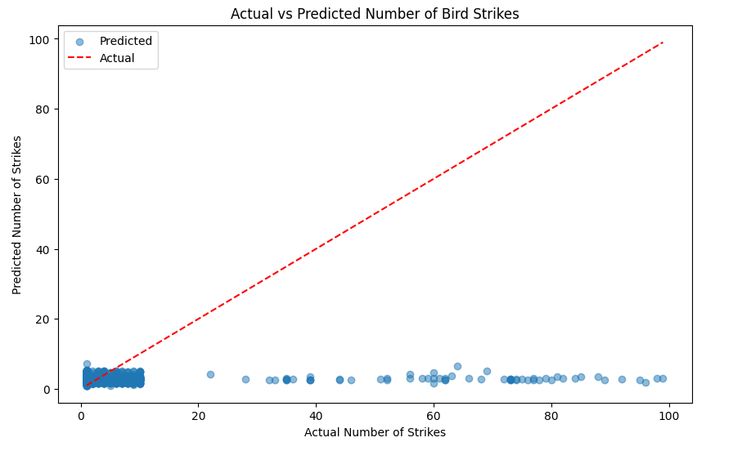
Trend Over Bird strike

Slide 9
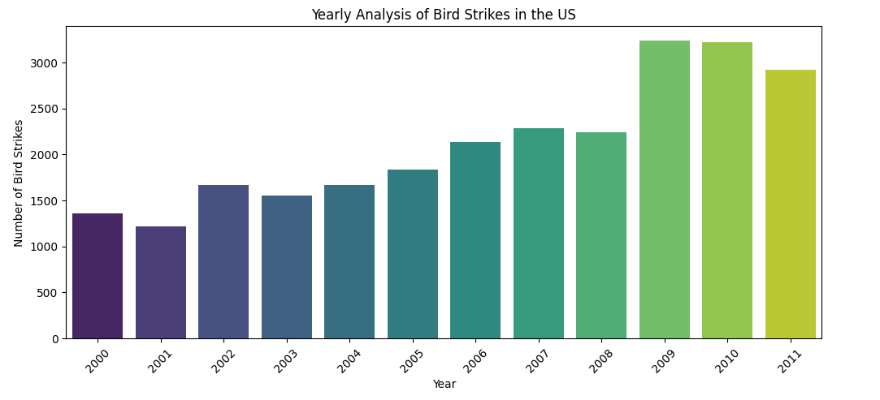
Yearly Analysis of Bird Strikes in the US
Increasing Trend: Bird strikes increased each year from 2009 to 2012.
Lowest in 2009: The fewest bird strikes occurred in 2009.
Highest in 2012: The number of bird strikes peaked in 2012.
Consistent Growth: There was no decrease in bird strikes over these four years.

Slide 10
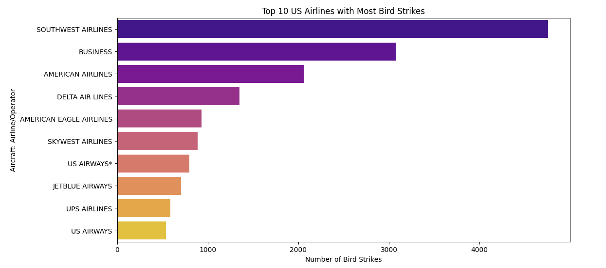
Top 10 US Airlines in terms of having encountered bird strikes
Southwest Airlines: Over 4000 bird strikes
American Airlines: Fewer than Southwest
Delta Air Lines: Fewer than Southwest
US Airways: Under 1000 bird strikes (lowest among top 10)

Slide 11
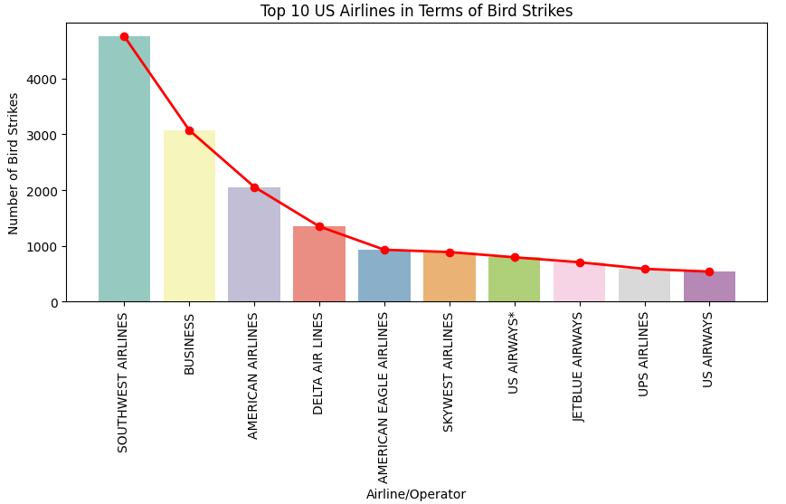
Top 10 US Airlines in terms of having encountered bird strikes
Southwest Airlines: Over 4000 bird strikes (most).
US Airways: Less than 1000 bird strikes (least).

Slide 12
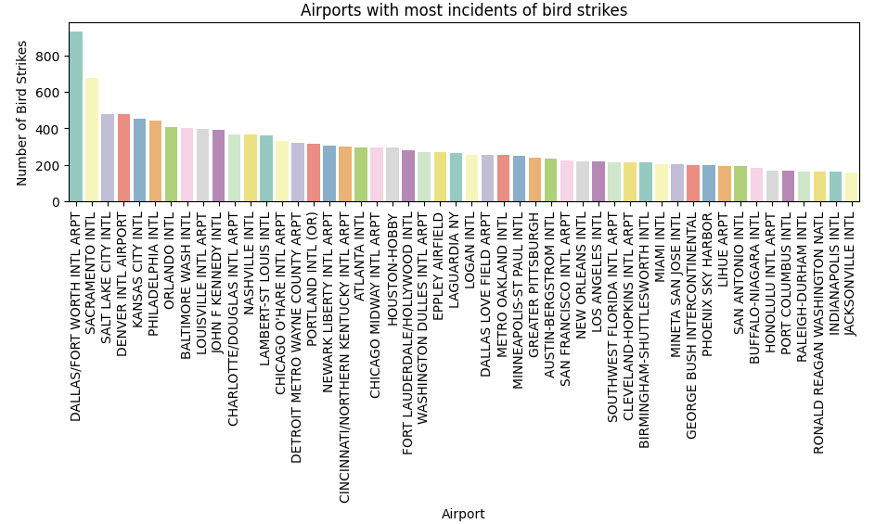
Airports with most incidents of bird strikes – Top 50

Slide 13
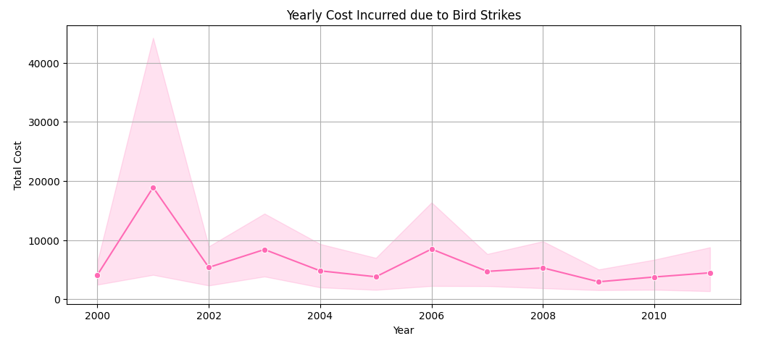
Yearly Cost Incurred due to Bird Strikes
Peak: 2002, just over 40000.
Trend: General decline after 2002, with fluctuations until 2010.

Slide 14
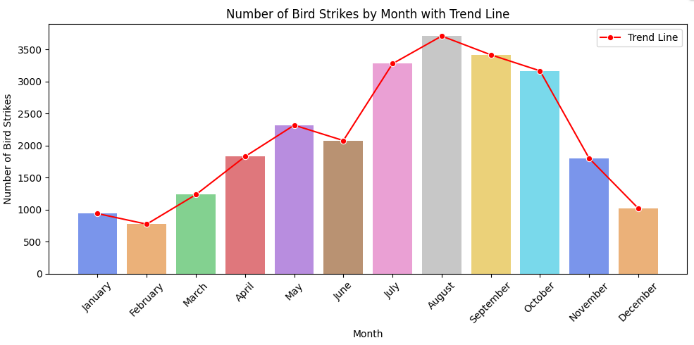
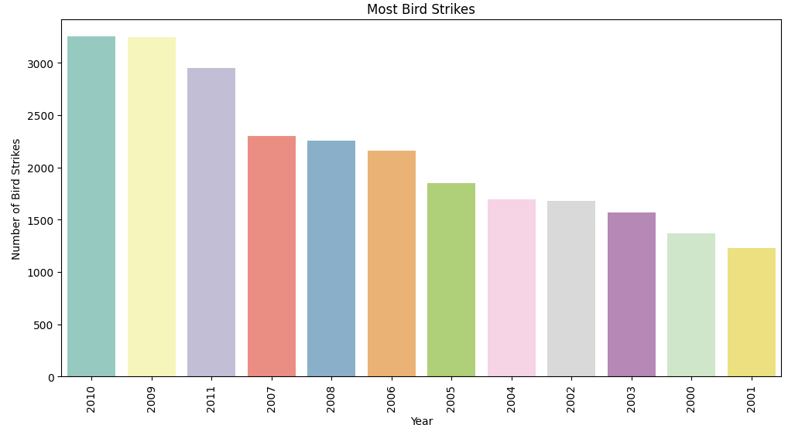
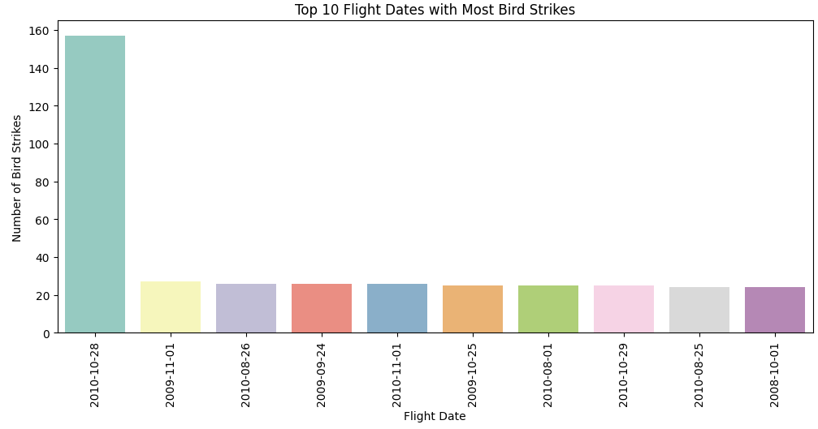
When do most bird strikes occur?

Slide 15
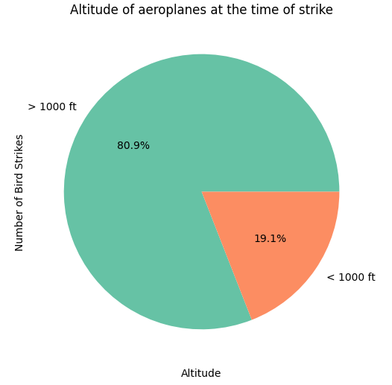
Altitude of aeroplanes at the time of strike
Above 1000 ft: The majority of bird strikes (80.9%) occur at altitudes above 1000 feet.
Below 1000 ft: A smaller portion (19.1%) of bird strikes happen below 1000 feet.

Slide 16
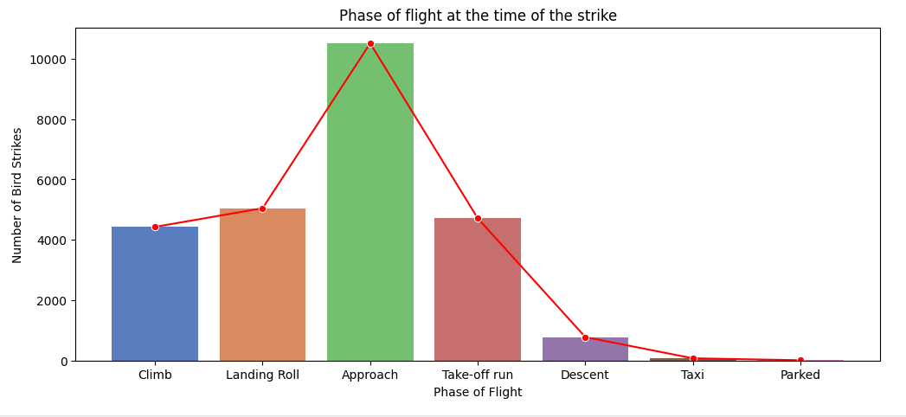
Phase of flight at the time of strike
Approach: Highest number of bird strikes.
Landing Roll: Second highest, but still significant.
climb and Take-off Run: Considerable number of strikes, less than Approach and Landing Roll.
Descent, Taxi, and Parked: Very few bird strikes.

Slide 17
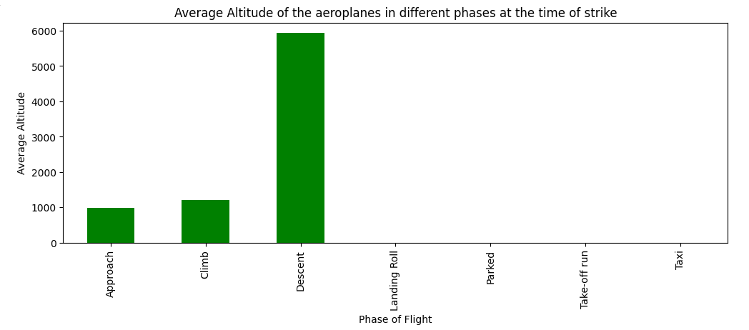
Average Altitude of the aeroplanes in different phases the time of strike

Slide 18
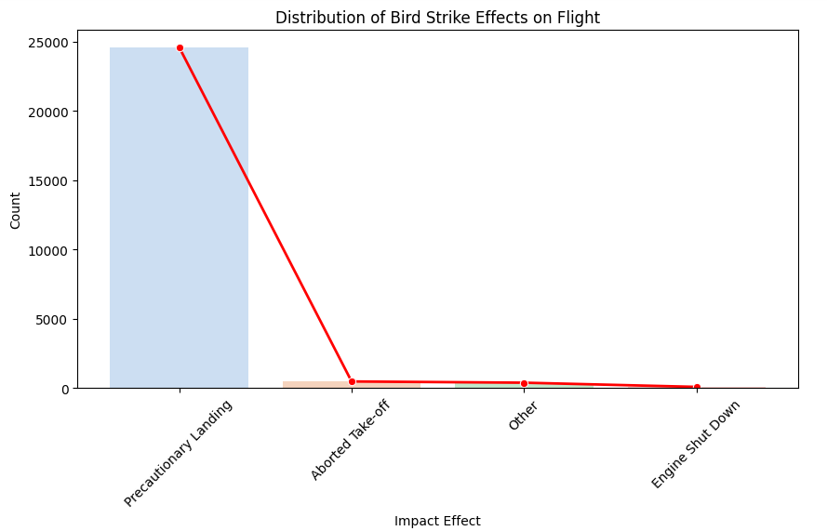
Effect of Bird Strikes & Impact on Flight

Slide 19
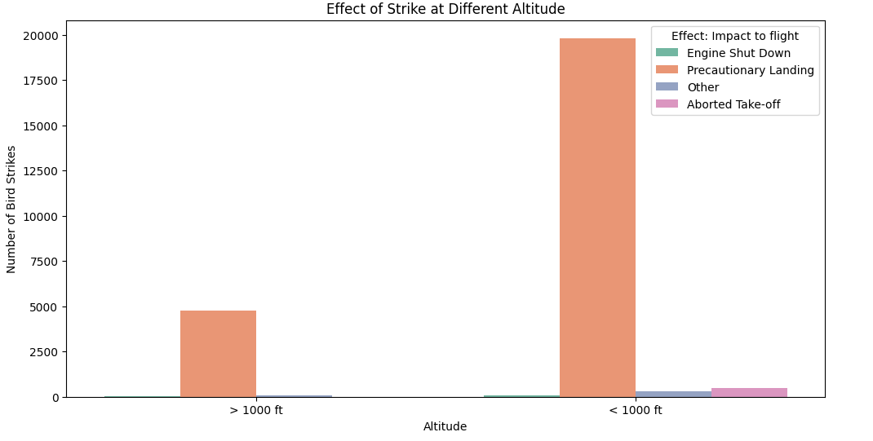
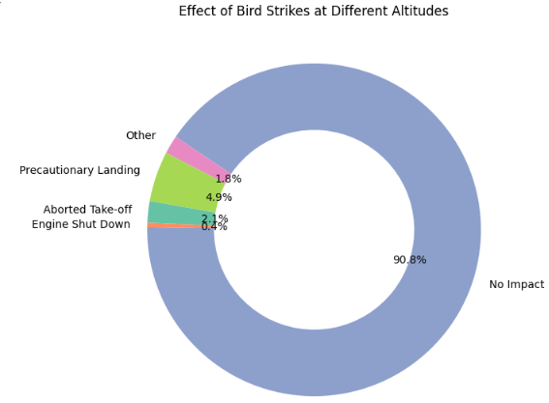
Effect of Strike at Different Altitude

Slide 20
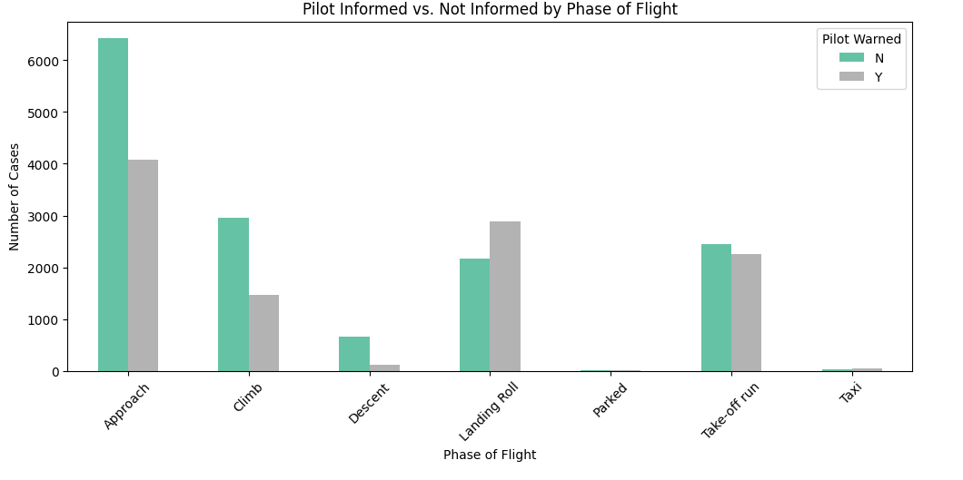
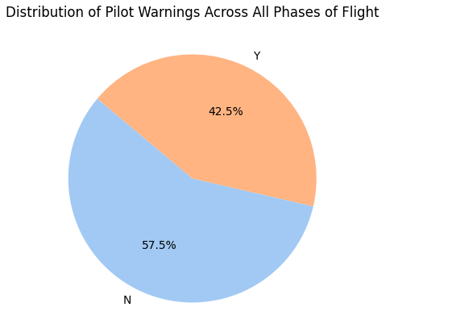
Were Pilots Informed?

Slide 21
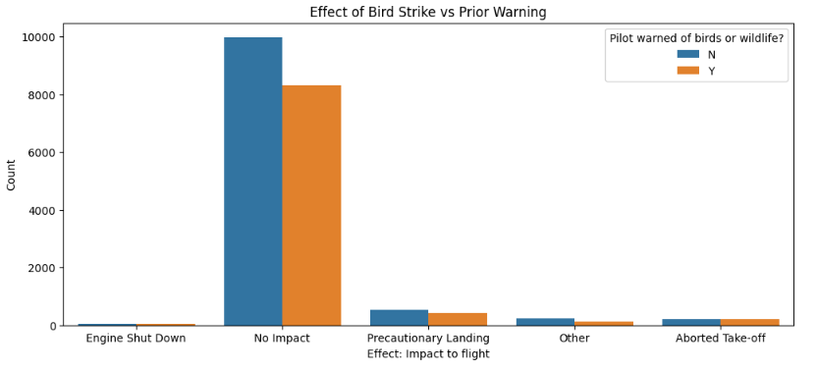
Prior Warning and Effect of Strike Relation

Slide 22
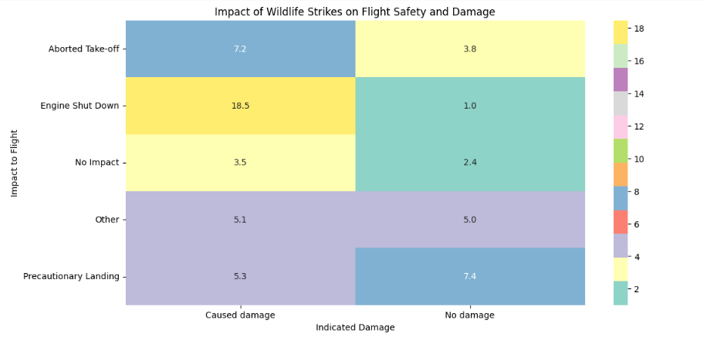
Impact of wildlife Strikes & Flight safty and damage

Slide 23
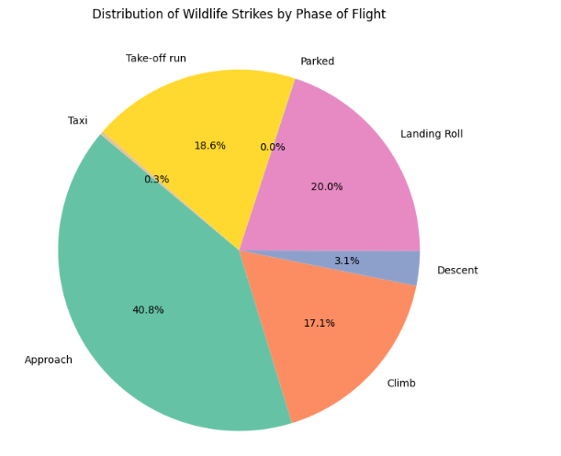
Distribution of wildlife strike by phase of flight
Approach Phase: Most wildlife strikes (40.8%) occur here.
Climb Phase: Second highest (17.1%).
Landing Roll and Take-off Run: Significant strikes during landing roll (20.0%) and take-off run (18.6%).
Minimal Strikes: Few during taxi (0.3%) and descent (3.1%)

Slide 24
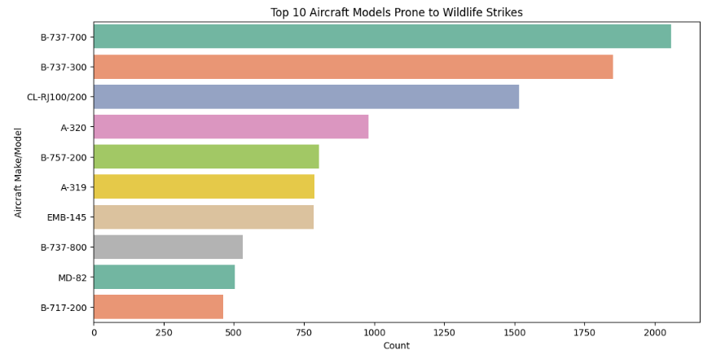
Top 10 aircraft models prone to wildlife strikes
B737-700: Highest count of wildlife strikes.
B737-300 and CRJ-100/200: Also have significant counts.
Other Models: Various other aircraft models with lower counts.

Slide 25
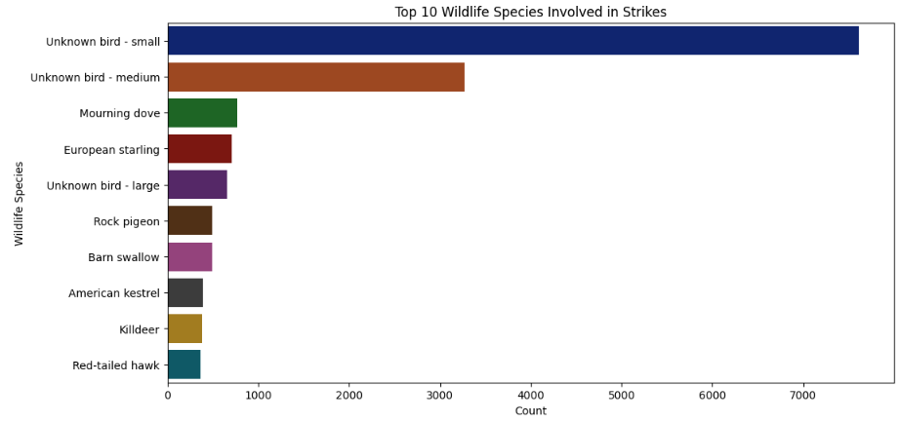
Top 10 wildlife species involved in strikes

Slide 26
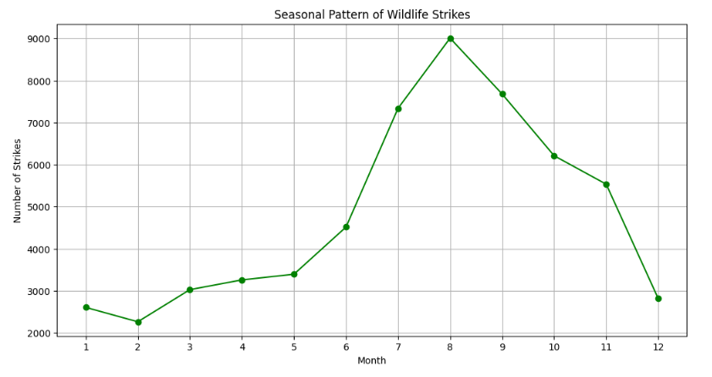
Is there any seasonal pattern in wildlife strike
Peak in July: Highest number of wildlife strikes.
Low at Year Start and End: Fewest strikes in January and December.
Increasing Trend: Strikes rise from January, peak in July, and decrease towards December.

Slide 27
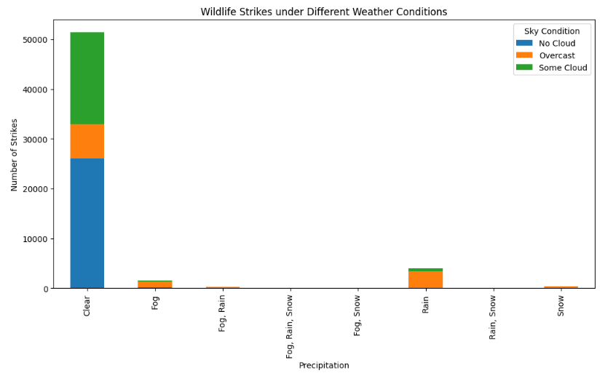
How does weather condition affect wildlife strike?

Slide 28
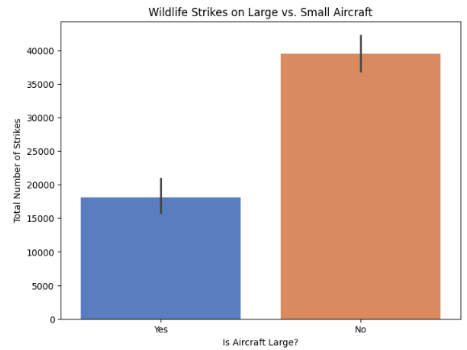
Do larger aircraft experience more wildlife strikes?

Slide 29
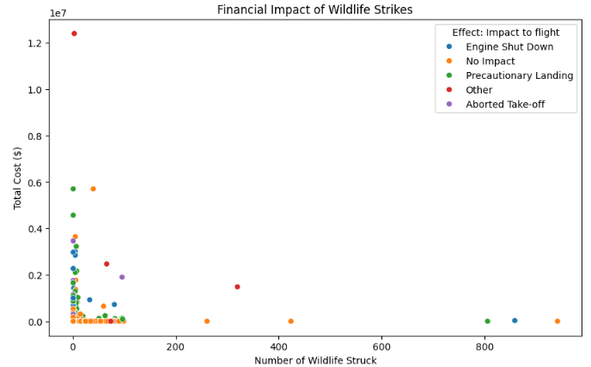
What is the financial impact of wildlife strikes?

Slide 30
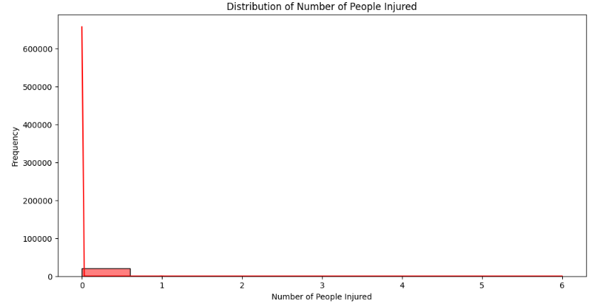
Distribution of number of people injured

Slide 31
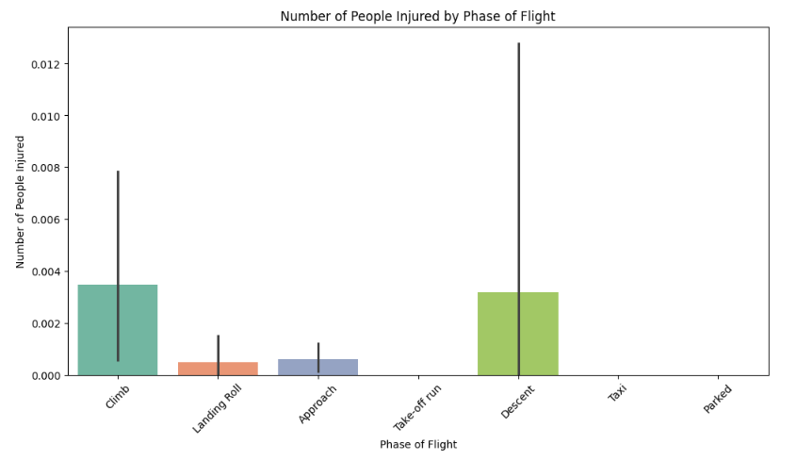
number of people injured by phase of flight

Slide 32
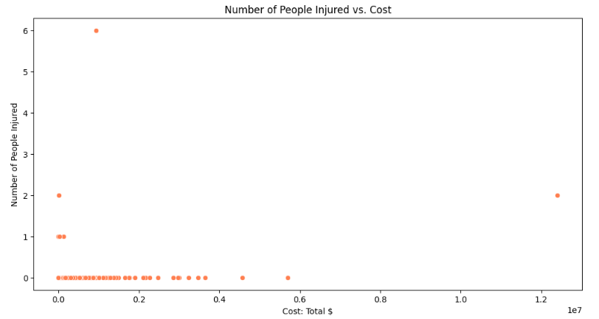
number of people injured vs. cost

Slide 33
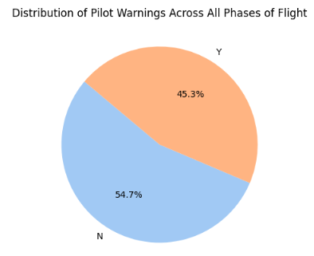
Distribution of pilot warning s across all phase of flight
No Warnings (54.7%): The majority of flights did not have pilot warnings.
Warnings (45.3%): A significant portion of flights had pilot warnings.

Slide 34
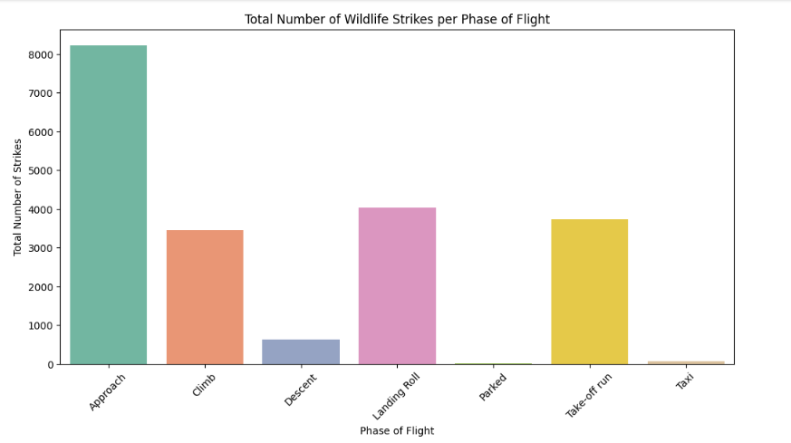
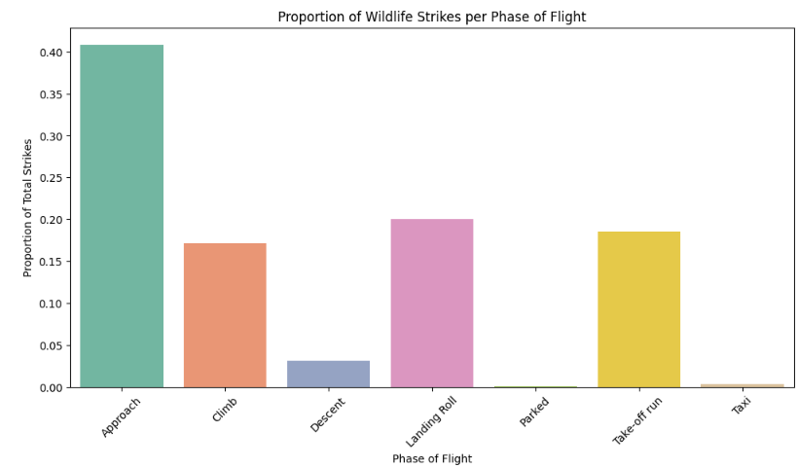
Does the phase of flight affect the likelihood of wildlife strikes?

Slide 35
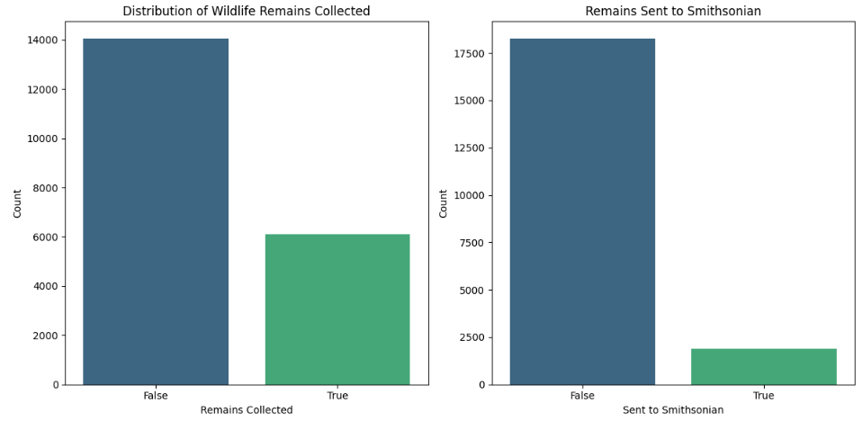
Distribution of wildlife remains collected
Sent to smithsonian

Slide 36
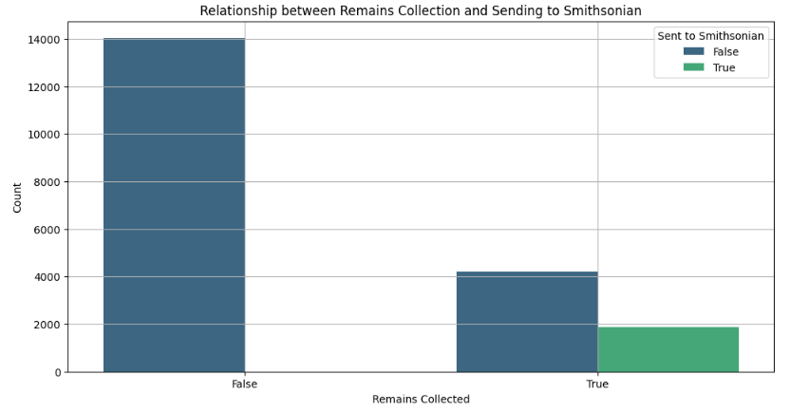
Relationship between remains collection
Sending to smithsonian

Slide 37
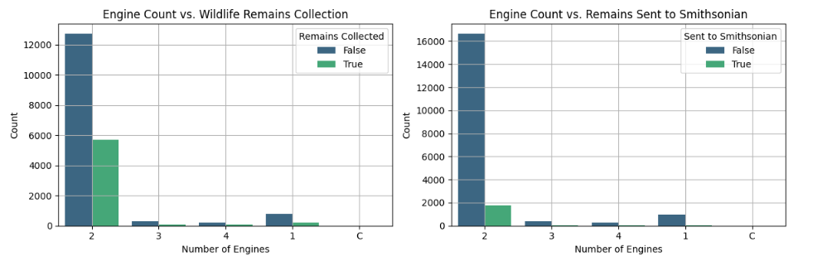
Engine count vs. wildlife remains collection & engine count vs. smithsonian

Slide 38
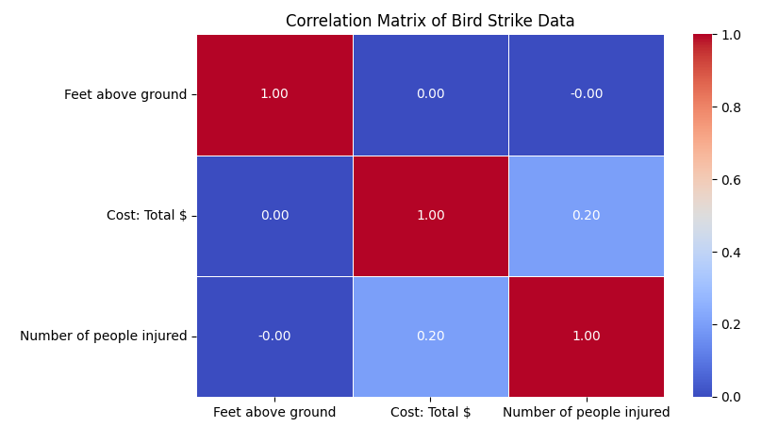
Effect of Bird Strikes & Impact on Flight

Slide 39
Key findings
Increasing Trend of Bird Strikes: The number of bird strikes increased significantly from 2000 to 2011, with notable peaks in 2009 and 2010, reaching around 3200 strikes each year.
Top Affected Airlines: Southwest Airlines experienced the highest number of bird strikes, over 4000, whereas US Airways had the fewest among the top 10, with less than 1000 strikes.
Cost Implications: The financial impact peaked in 2002, just over $40,000, with a general decline and fluctuations in subsequent years until 2010.
Altitude and Flight Phase: Bird strikes occurred at various altitudes and flight phases, affecting aircraft differently based on these factors.

Slide 40
Key findings
Pilot Warnings: The presence and effect of prior warnings about wildlife varied, influencing the impact of the strikes.
Wildlife Species and Aircraft Models: Specific wildlife species and aircraft models were more prone to strikes, indicating patterns in the data.
Seasonal and Weather Effects: Seasonal patterns and weather conditions influenced the frequency and impact of bird strikes.
Collection of Remains: The relationship between collecting wildlife remains and sending them to the Smithsonian, along with the impact of engine count on these processes, was analyzed.

Slide 41
conclusion
The report underscores the growing concern of bird strikes in aviation, highlighting the importance of understanding the conditions and factors contributing to these incidents.
The increasing trend over the years calls for enhanced measures in wildlife management and pilot awareness.
The financial implications and the varying impact on different airlines and aircraft models suggest a need for targeted strategies to mitigate risks.
Collecting and analyzing wildlife remains provide valuable insights for improving safety protocols and preventing future incidents.

Slide 42
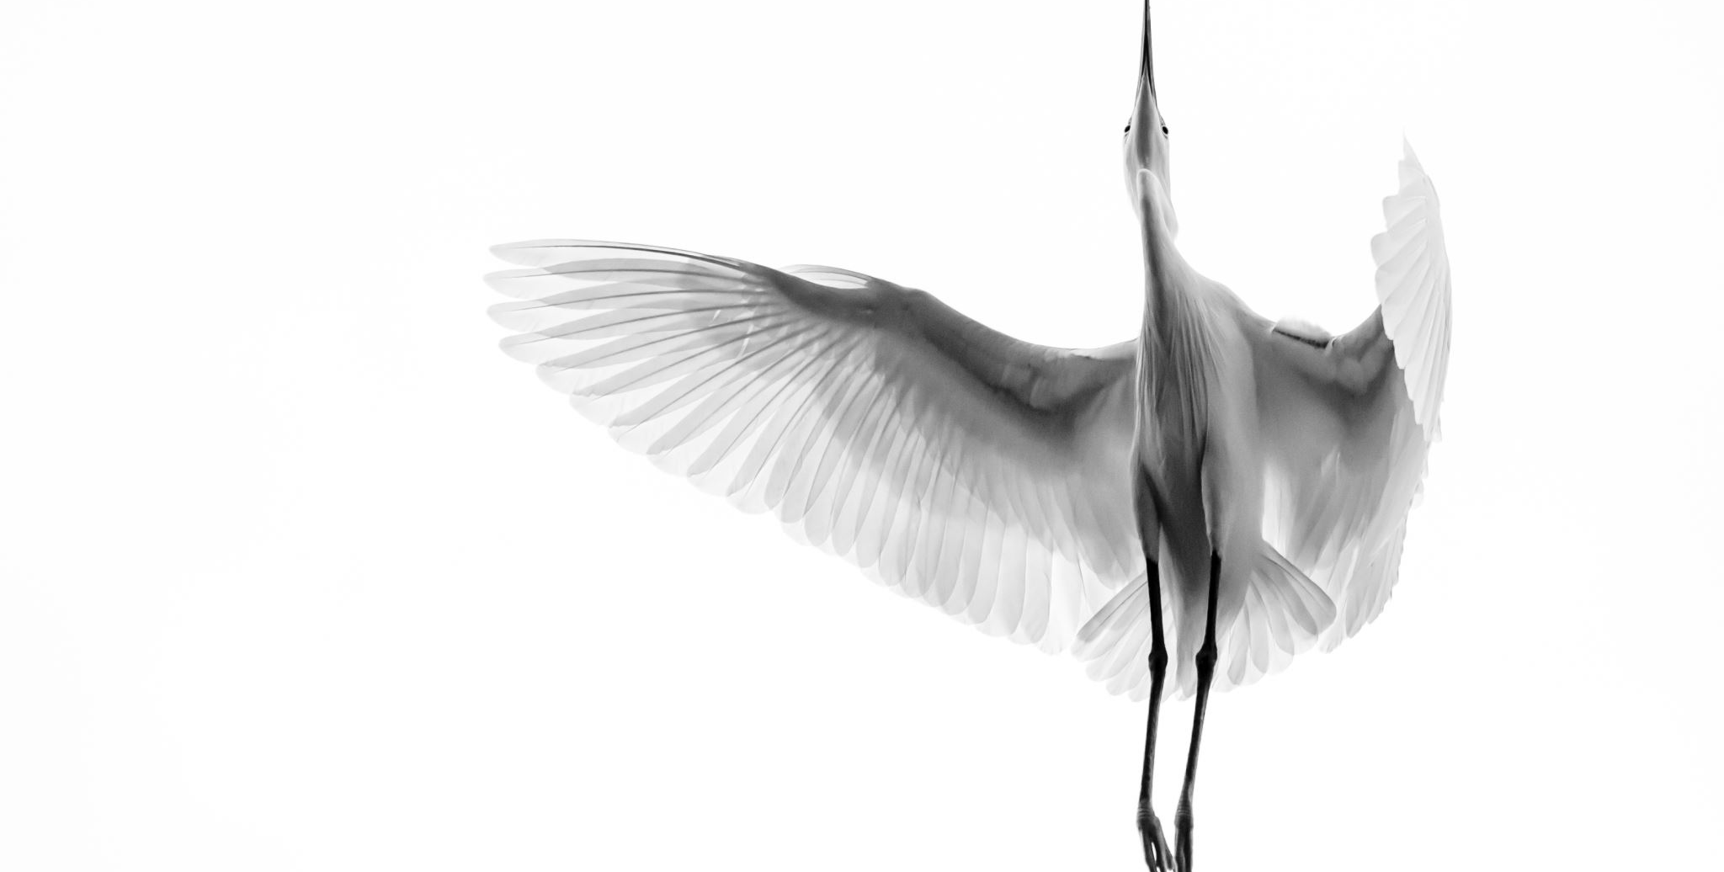
Thank You

